Slide 1
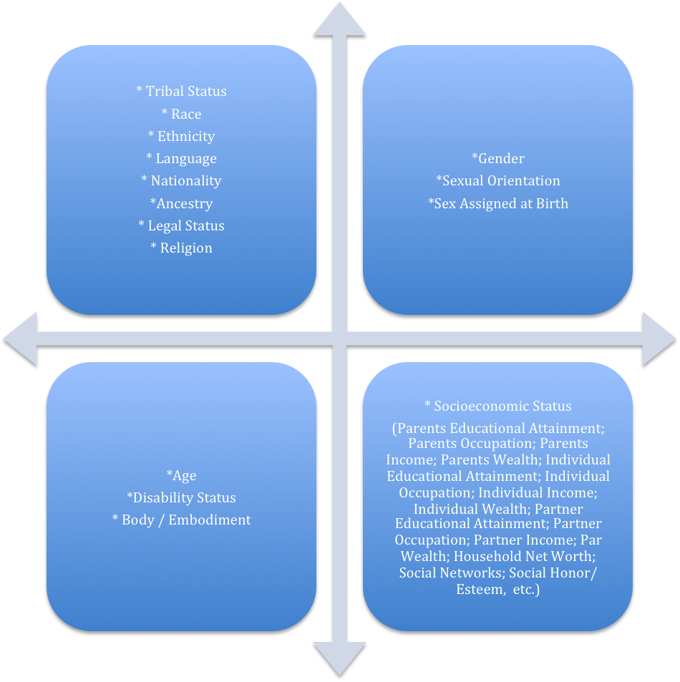
CONCEPTUALIZING & VISUALIZING INTERSECTIONALITY
Nancy López 2017, nlopez@unm.edu, Visit: race.unm.edu
Institute for the Study of “Race” & Social Justice,
New Mexico Statewide Race, Gender, Class Data Policy Consortium
On-going Self-Reflexivity About Your Intersecting
Social Location and Category of Experience
CULTIVATING TRANSFORMATIONAL INTERSECTIONAL CAPITAL (TIC)
Notes:
In your opinion what is race, ethnicity, language, ancestry national origin. Think about how your own lived experience and academic training shape your understandings of these terms.
Can you use the same question to capture dfferent questions?

