Slide 1
OCTOBER 1, 2019
Let's Get Digital
Christina Brigance & Amy Muchna

Slide 2
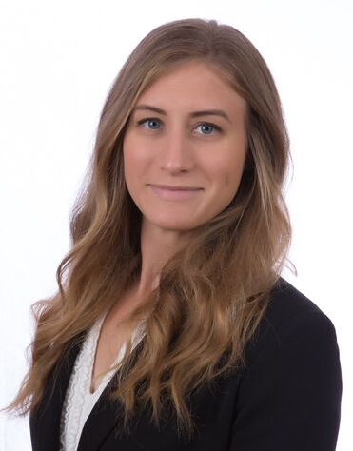
Who We Are
Christina Brigance
Amy Muchna
Maternal and Child Health Epidemiologist
New Mexico Department of Health
Evaluation Specialist
Albuquerque Area Southwest Tribal Epidemiology Center

Slide 3
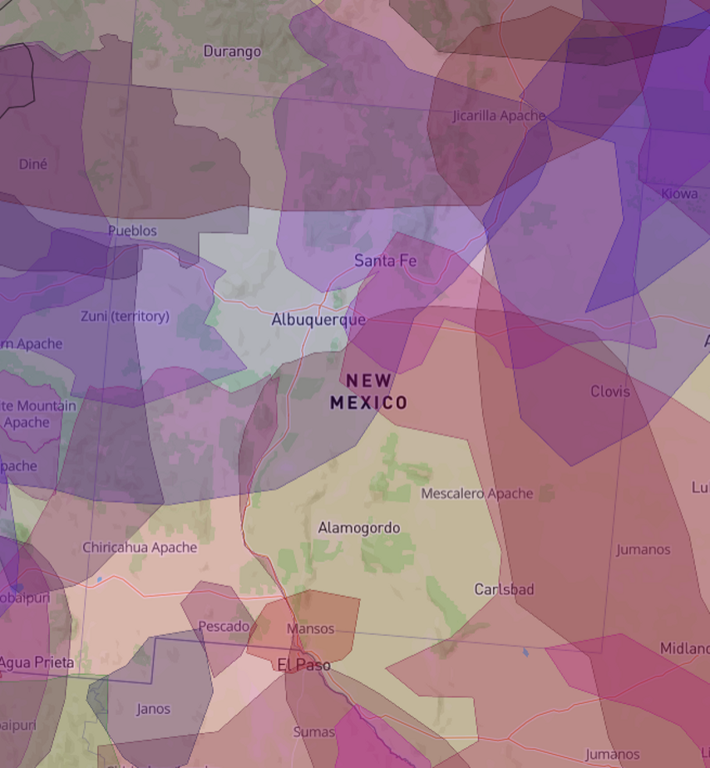
Territory
Acknowledgement
We acknowledge that we work and live on the stolen ancestral lands of the Pueblos, Apache, and Navajo sovereign nations, and we honor and express gratitude to those nations.
https://native-land.ca/

Slide 4
Today's Presentation
WHAT WE'LL COVER:
Livestories
Canva
Infogram
Vyond
Additional Resources
Q&A

Slide 5
Who You Are
Please open your phone internet browser and type in:
pollev.com/aastec

Slide 10
LiveStories

Slide 11
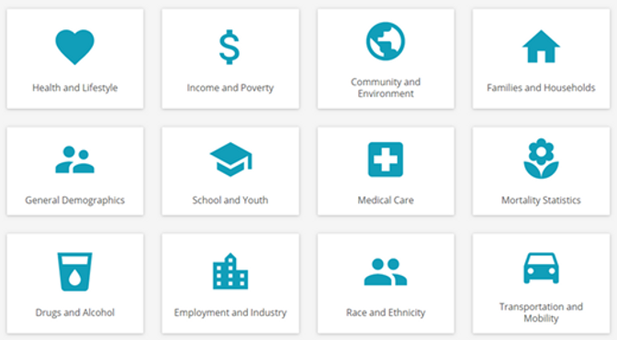
What can we do with LiveStories?
A web-based platform that enables organizations to publish data dashboards, narrative stories or a mix of both
https://insight.livestories.com/s/v2/new-story/df1508c1-81be-4cf3-8466-5f8ad783e2f8
Holds your personally uploaded data and also has a large data library searchable by:
Indicator
Data source
Year
Data sources come from publicly available government sources
https://www.livestories.com/statistics

Slide 12
Pros
Cons
Has a large data library from which to make stories
It is simple to create stories from this data
Makes beautiful, simple stories
Very involved company- TA and webinars
Easily shareable to many social media platforms or by URL or embedding
LiveStories will save and share
Google searchable
Other LiveStories members can share
Using data sets outside the program
Almost, but not stand alone (photos)
Not very intuitive

Slide 13
Canva

Slide 14
What can we do with Canva?
Products
Infographics, social media posts, presentations, flyers, logos, blog posts
Access
Images, layouts, icons, graphics, photos
Capabilities
Publish online, print for display, share with collaborators
Downloads
JPG, PNG, PDF, Video, Animation (GIF)

Slide 15
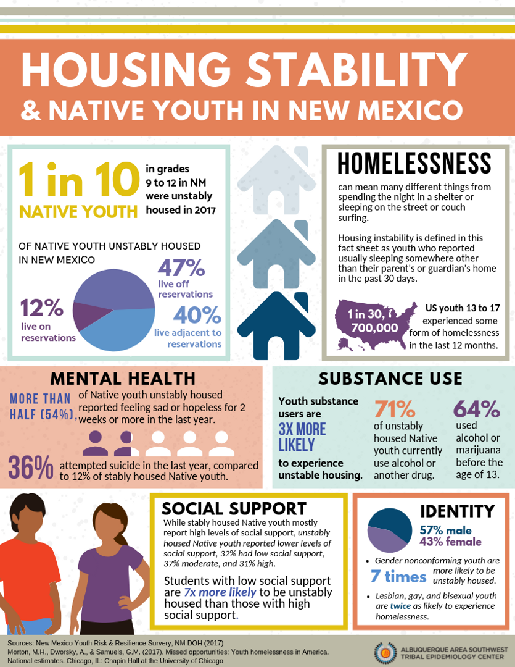
Infographics
CAN BE SAVED AS PDF WITH LINKS OR AS .PNG OR .JPEG

Slide 16
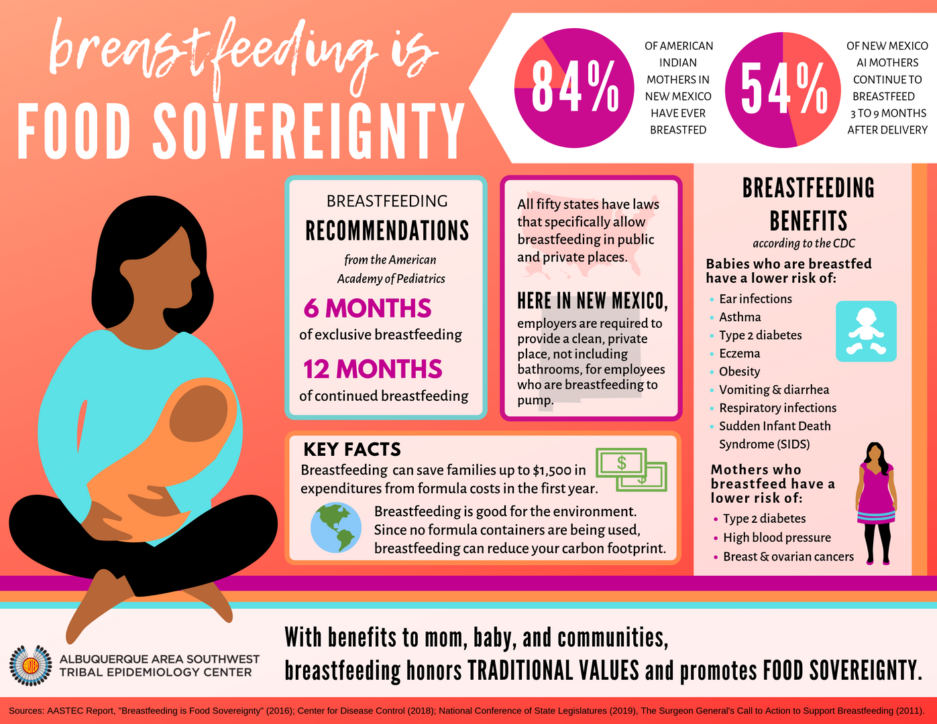

Slide 17
Social Media Posts

Slide 18
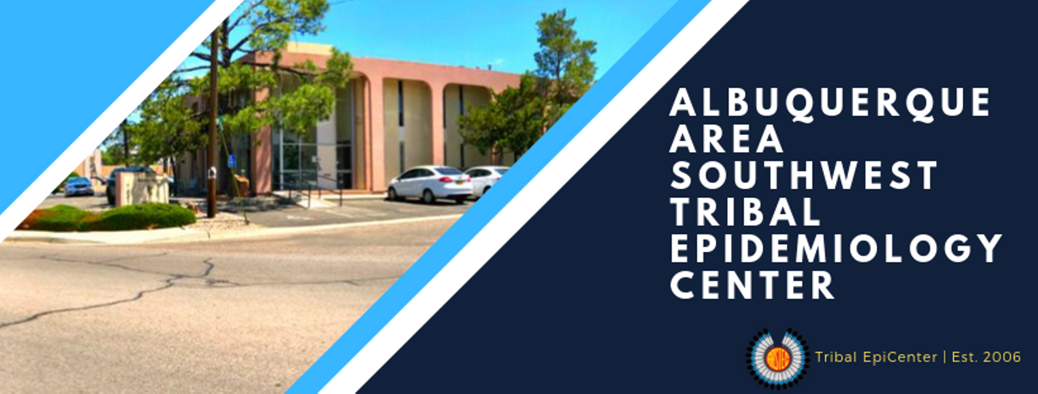

Slide 19
Infogram

Slide 20
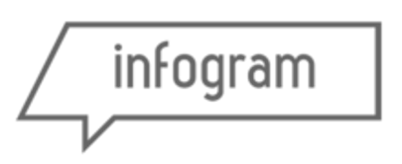
What can we do with Infogram?
Products
Infographics, reports, slides, dashboards, social media posts
Access
Interactive graphs, images, layouts, icons, graphics, photos
Capabilities
Publish online, print for display, share with collaborators, website analytics
Downloads
PDF, JPG, PNG

Slide 21
Infographics
CAN BE SAVED AS PDF OR EMBEDDED ONLINE WITH ANIMATIONS

Slide 22
Timelines
CAN BE SAVED AS PDF OR EMBEDDED ONLINE WITH ANIMATIONS

Slide 23
Reports
CAN BE SAVED AS PDF OR EMBEDDED ONLINE WITH ANIMATIONS

Slide 24
Vyond

Slide 25
What can we do with Vyond?
https://app.vyond.com/videos/accb8b4c-20f7-4e0a-8c63-985e1d5a0b35
An animation video software that includes images and music
Web based
Has multiple uses:
Data presentation
Training
Marketing
Story telling

Slide 26
Pros
Cons
Easy for those without any video experience
Professional quality
Large variety of images for scene creation
Intuitive and creative
Readily accepted by audiences
Youth friendly!
Only works in Chrome, Firefox, Edge
Bandwidth
Downloading and sharing
Only one-person access
Occasional audio glitches
Limited to animated video only

Slide 27
ADDITIONAL RESOURCES
We like them and we think you will too!

Slide 28
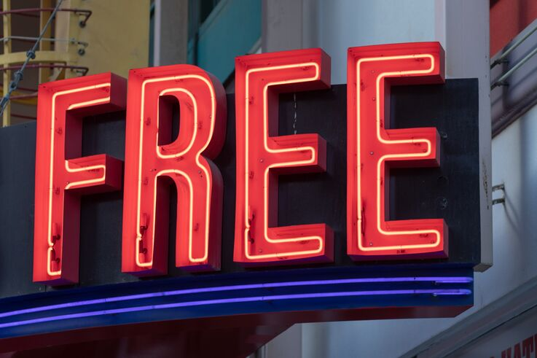
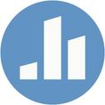
Additional *FREE* Resources
The Noun Project
Unsplash
Epi Info
Survey Monkey
Poll Everywhere
Microsoft Sway

Slide 29
Questions & Discussion
What are your favorite digital reporting tools?

Slide 30
Resource List
Livestories
Canva
Infogram
Vyond
The Noun Project
Unsplash
Epi Info
Survey Monkey
Poll Everywhere
Microsoft Sway

Slide 31
Thank you!

Slide 32
Feel free to reach out!
CONTACT US:
Christina
Christina.Brigance@state.nm.us
Amy
amuchna@aaihb.org

